Slide 2

TEAM

Slide 3
I am only one but I am one
I cannot do everything but I can do some thing and I will not let what I cannot do interfere with what I can do. – Edward Hale

Slide 4
TEAM

Slide 5
T
E
A m
Together
Everyone
Accomplishes
More

Slide 6
Teamwork is the ability to work together toward a common vision. The ability to direct individual accomplishments toward organizational objectives. It is the fuel that allows common people to attain uncommon results. - Andrew Carnegie

Slide 7
Teamwork makes the Dreamwork
we are here to work for a dream not just a paycheck

Slide 8
“Paul and Timothy, servants of Christ Jesus,
To all the saints in Christ Jesus who are at Philippi, with the overseers
and deacons:” Phil 1:1
1401 [e]
douloi
δοῦλοι
servants
N-NMP
1985 [e]
episkopois
ἐπισκόποις
[the]overseers
N-DMP
1249 [e]
diakonois
διακόνοις :
deacons
N-DMP

Slide 9
There is ONE TEAM with invisible leadership and it is made up of humble and hungry hearts.

Slide 10
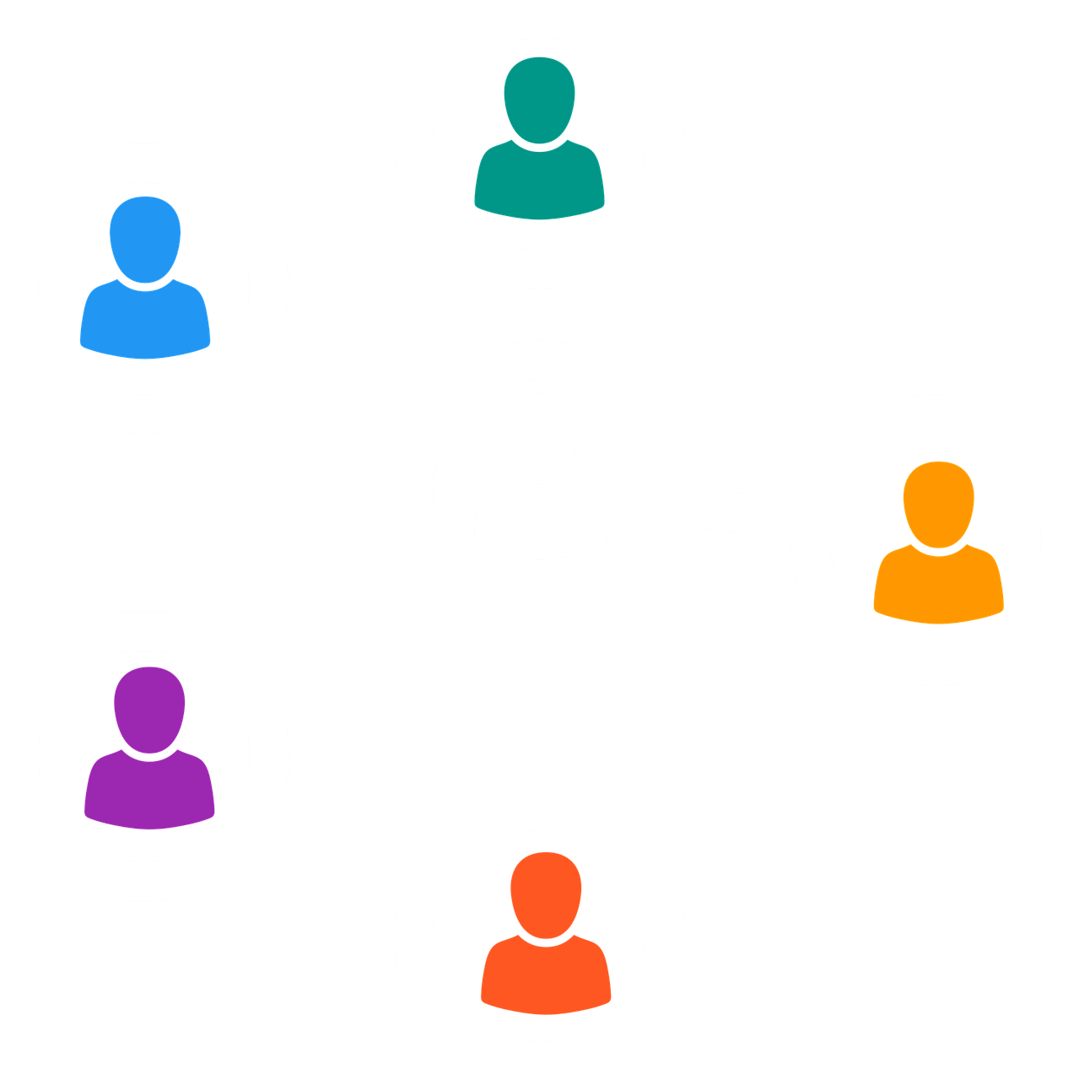
every TEAM has TEMPERAMENTS

Slide 11
Without co-operation real success is impossible. We can only do so much by ourselves.
By channeling efforts, talents and resources of other people, we can not only succeed faster and easier but also help them utilize their God given abilities.
Only by doing so can we become all that we can be in this life which is very short in reality.

Slide 12
TEAM

